Slide 1
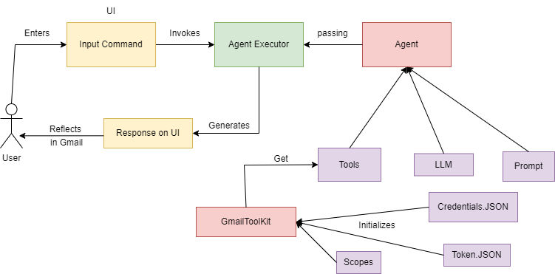
Email Assistant Architecture diagram:
Business value proposition:
Quick Information Retrieval
Improved communication
Accuracy and efficiency
Time Savings
Enhanced customer experience
Reduced workload and employee satisfaction
Features of the application:
Create draft emails
Send emails
Retrieve content of the emails
Summarizing the content of email
Generate reply back emails
Searches for the specific information

